Slide 1

THE FULL STACK WEB DEVELOPER BOOTCAMP 2022
Starting soon.

Slide 2
Full stack web development ???
Full stack web development is technology that you can develop both the frontend and backend of your web application.
Its divided into two :-
1. Frontend development which includes everything a customer or website viewer can see and interact with.
2. Backend development which includes maintaining and processing of the data.

Slide 3






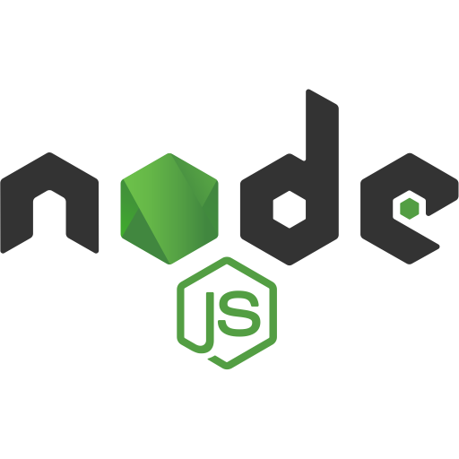






What are we going to learn ?
Full stack web development
FRONTEND Vs. BACKEND
Frontend technologies.
Backend technologies
Version control
Visual studio code
HTML5
CSS3
tailwindcss
JavaScript
React JS

Slide 4
TECHNOLOGIES LOOK UP.

Slide 5
HTML 5
HTML - Hyper text markup language.
HTML is used to manipulate text, images and other content in order to display it in the required format.
It was developed by Tim Berners lee – 1991
The first version was HTML 1.0, but the first standard version was HTML 2.0 published in 1995.
This is the main file which our websites run on.
1

Slide 6
CSS 3
CSS – stands for cascading style sheet
CSS describes how the HTML looks like in the screen.
It allows us to apply styles to the web pages.
CSS saves time.
CSS helps designers to position every element in the web page.

Slide 7
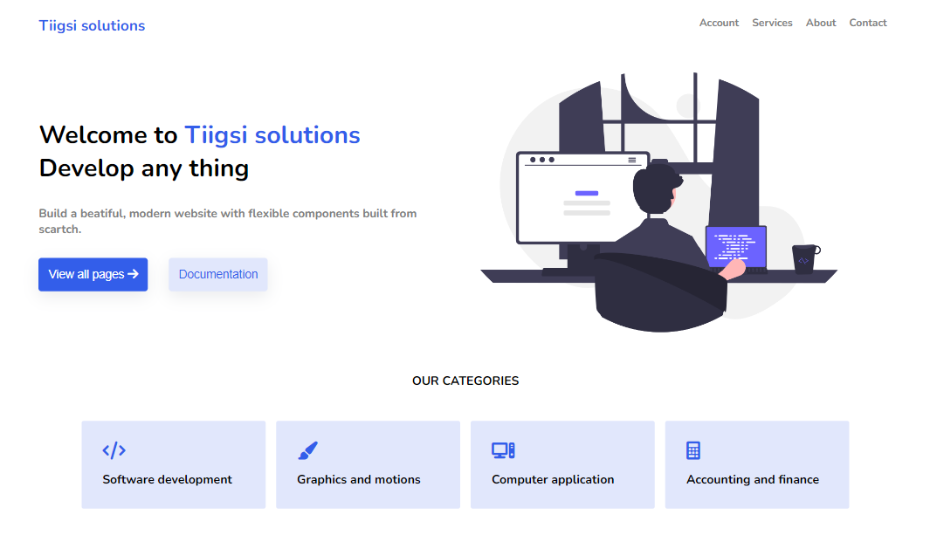
What are going to build with HTML & CSS

Slide 8

TAILWIND CSS
Tailwind CSS is basically a utility-first CSS framework for rapidly building custom user interfaces.
It is a utility-first CSS framework which means we can use utility classes to build custom designs without writing CSS as in traditional approach.
No more silly names for CSS classes and Id’s
Minimum lines of Code in CSS file.
Makes the website responsive.
Makes the changes in the desired manner.

Slide 9

CLI
A command-line interface (CLI) is a text-based user interface (UI) used to run programs, manage computer files and interact with the computer.
Using git to create, delete and rename folders and also the files.

Slide 10
JAVASCRIPT
Javascript is the world’s most popular programming language.
Its also known as scripting language for web pages.
Its not only used for web pages but it can also create millions of well paid jobs.
Javascript allows the user to interact with the website.
Javascript can be used Client-side, not only that but also it can be used in the server side.

Slide 11
REACT JS
React is the most popular JavaScript library for building web applications.
It was developed by Meta previously known as Facebook 2011.
React is used by Facebook, Netflix, Airbnb and many more.
Its alternatives include vuejs, angular and Xamarin.

Slide 12
NODE JS
Node.js is an open-source and cross-platform runtime environment for executing JAVASCRIPT code outside a browser.
You need to remember that NodeJS is not a framework and it’s not a programming language.
We often use Node.js for building back-end services like APIs like Web App or Mobile App.
It’s used in production by large companies such as PayPal, Uber, Netflix, Walmart, and so on.

Slide 13
Express JS
Express is Node.js based web application framework
It is an open source framework developed and maintained by the Node.js foundation.
It requires less development and maintenance cost.

Slide 14
PostgreSQL
PostgreSQL, also known as Postgres, is relational database management system focused on scalability and SQL compliance. It was originally called POSTGRES, referring to its origins as the successor to the Ingres database developed at the University of California, Berkeley.
Originally released in 1986
PostgreSQL is mainly used to store data for web applications and mobile apps.
Its awarded for the “DATABASE SYSTEM OF THE YEAR” several times due to its highly scalability, reliability and security.
Its open-source

Slide 15
MongoDB - NoSQL
MongoDB is an open source NoSQL database management program
As a non-relational database, it can process structured, semi-structured, and unstructured data. It uses a non-relational, document-oriented data model and a non-structured query language.

Slide 16
BUT WE ARE LEARNING MORE THAN THAT

Slide 17
STEVE KLABNIK’S 9 TIPS FOR NEW PROGRAMERS
Always stick on one task at a time.
Different people find different things easy.
Your work can only be 80% complete
Learn how to Google
Don’t be afraid to ask for help or help others back.
Technology always changes
Programmers always fail
Don’t give up.

